Slide 1
Generative AI
Made By – Tanuj Kamboj
Department – Cse

Slide 2
AITools
*Crayion
*Synthesia
*Veed.io
*Prisma labs
*Deep Dream

Slide 3

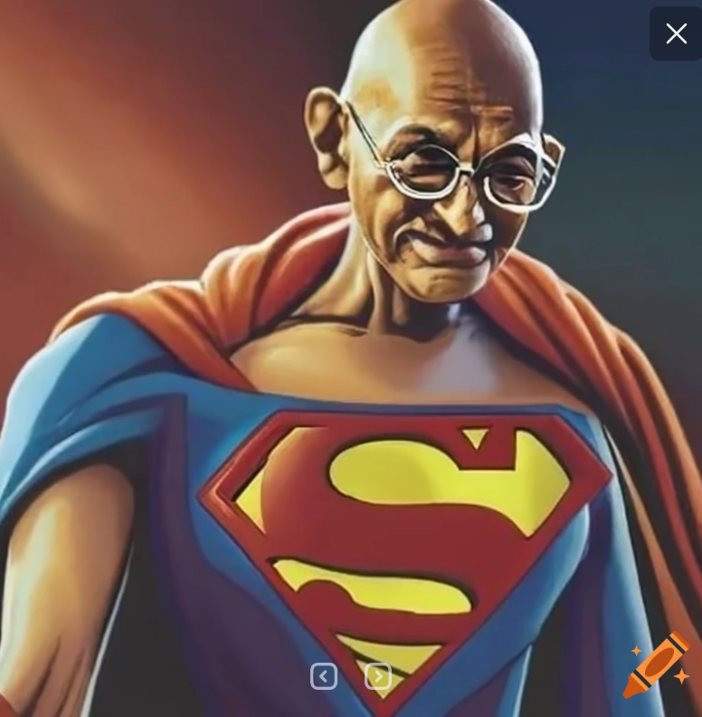
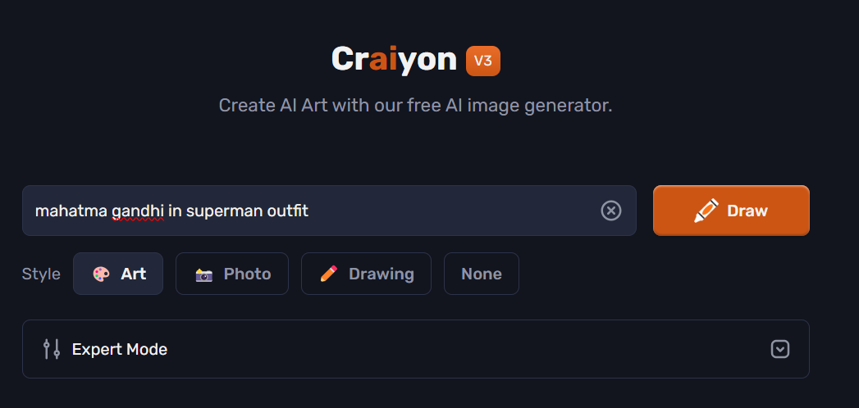
Craiyon
Crayon AI uses advanced technologies like Generative Adversarial Networks (GANs) to generate images. GANs consist of a generator that creates images and a discriminator that evaluates their realism. These models are trained on large datasets to learn patterns and create realistic images across various applications, from art to medical imaging. Users interact with Crayon AI through its platform or API to generate images tailored to their needs or preferences.

Slide 4

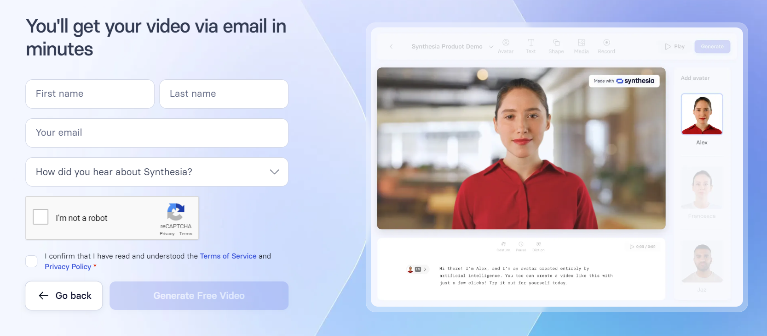
Synthesia
Synthesia is a tool that uses AI to make videos of people talking, just from written text. It makes the person's face move and their lips sync up with the words, like they're really speaking. It's used for making videos, language learning, and helping people understand things better.

Slide 5
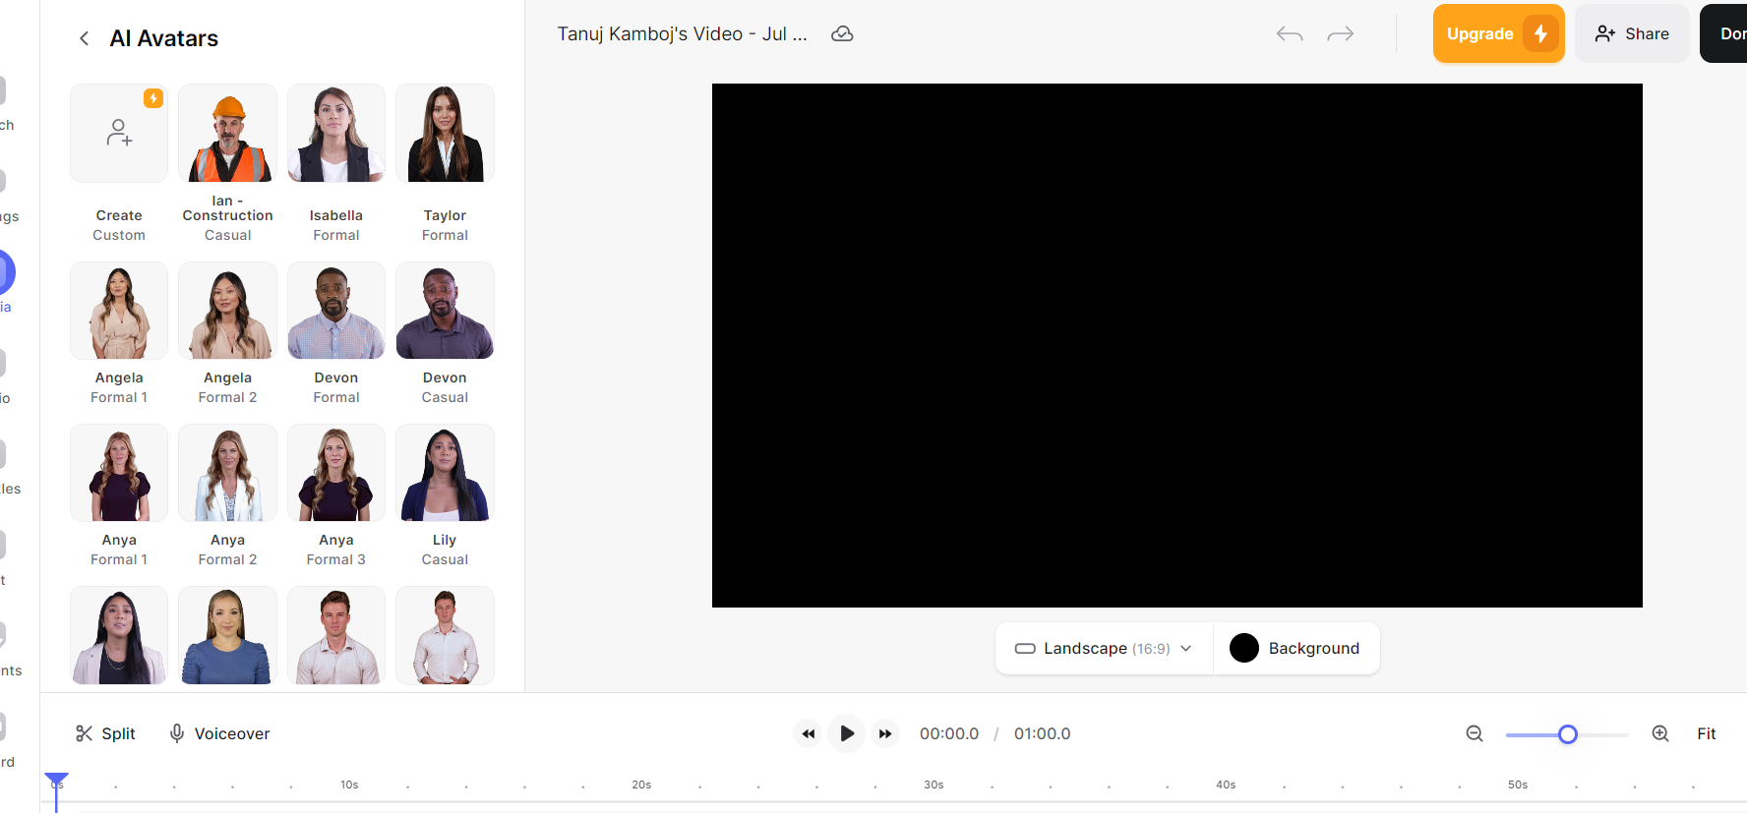
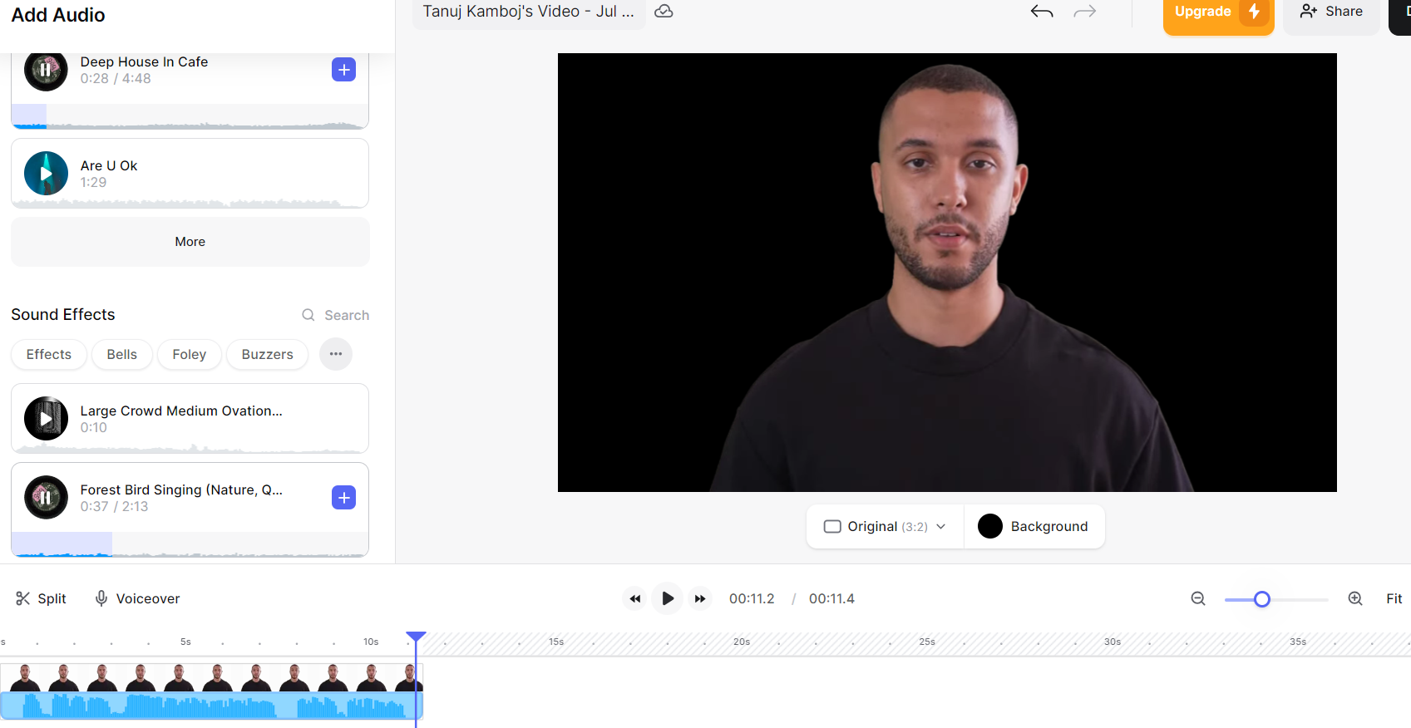
Veed.io
Veed.ai is a tool that simplifies video editing using artificial intelligence. It offers features like automatic subtitles, video trimming, adding text and animations, and converting audio to text. This makes it easier for users to create and customize videos without needing advanced editing skills.

Slide 6
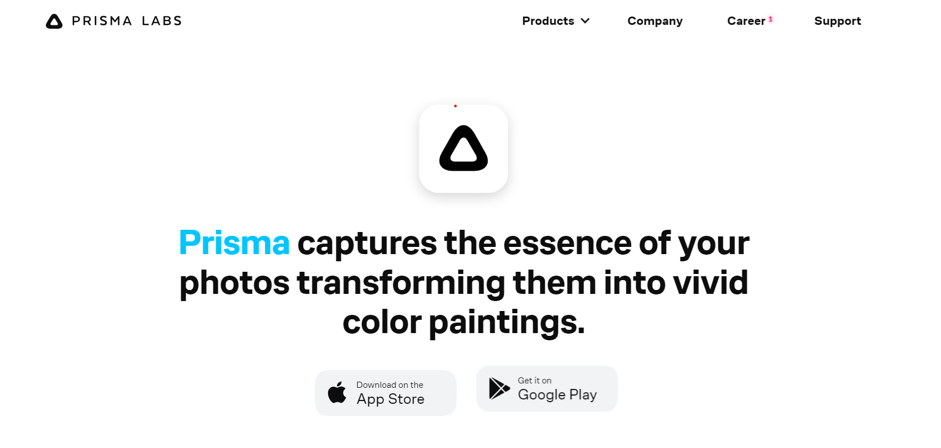
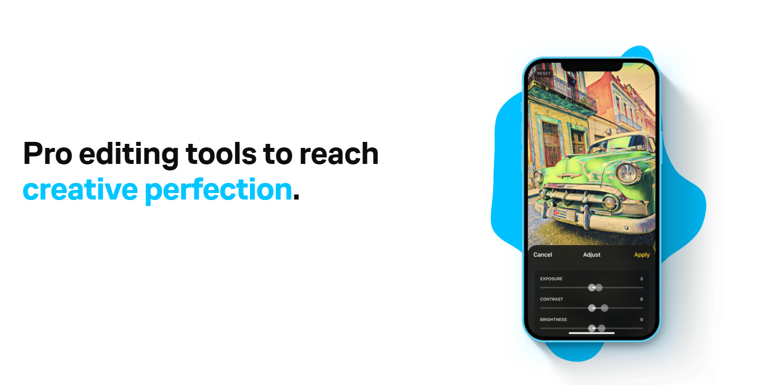
Prisma Labs
Prisma Lab is a photo editing tool that uses AI to turn your photos into beautiful artworks inspired by famous artists. It applies artistic filters to your pictures, making them look unique and eye-catching with just a few taps

Slide 7
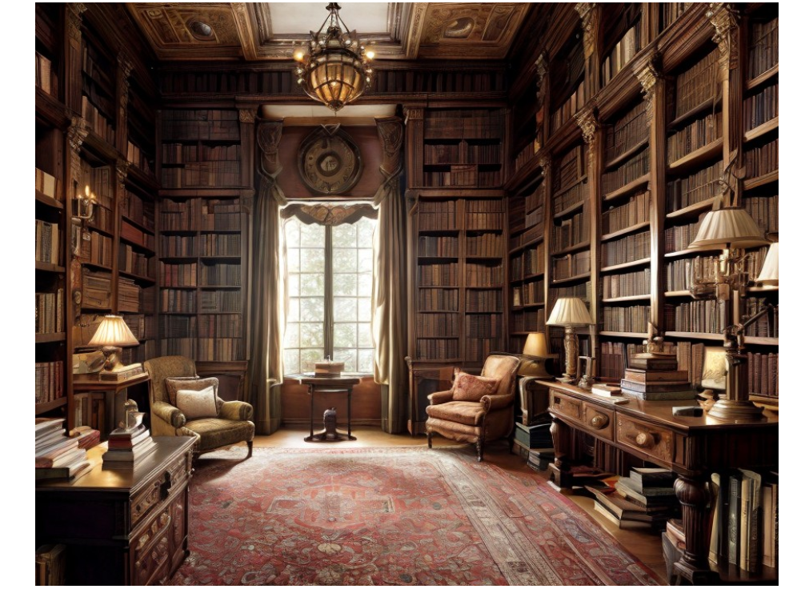
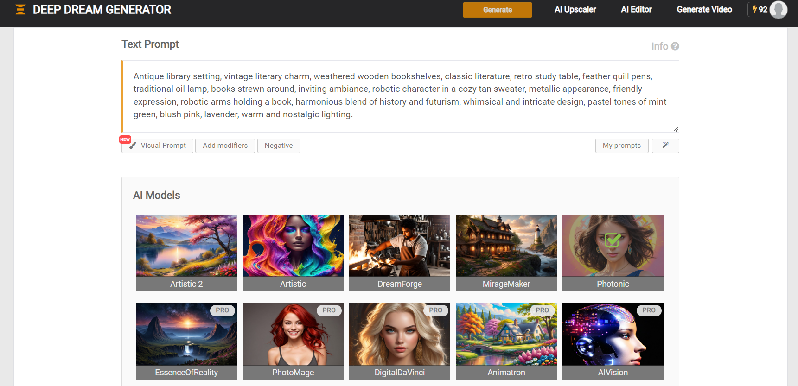
Deep Dream
Deep Dream Generator, make amazing AI art, photos, videos in seconds! Unleash your creativity – and join DDG's vibrant online community of AI artists!

Slide 8
Conclusion
In conclusion, while generative AI offers remarkable opportunities for innovation and efficiency, it also demands responsible deployment to mitigate risks and ensure its benefits are widely accessible and ethically applied. Its development represents a pivotal moment in the intersection of technology and creativity, shaping the future landscape of industries and society at large.

Slide 9


